Slide 1

Efficient GPU Screen-Space Ray Tracing
Michael Mara Morgan McGuire
Stanford University
and Casual Effects
Williams College
and Casual Effects
Image © 2015 Unity & Casual Effects
Morgan McGuire and Michael Mara, Efficient GPU Screen-Space Ray Tracing, Journal of Computer Graphics Techniques (JCGT), vol. 3, no. 4, 73-85, 2014
http://jcgt.org/published/0003/04/04/
Notes:
This is work done in conjunction with Morgan McGuire of Williams College

Slide 2
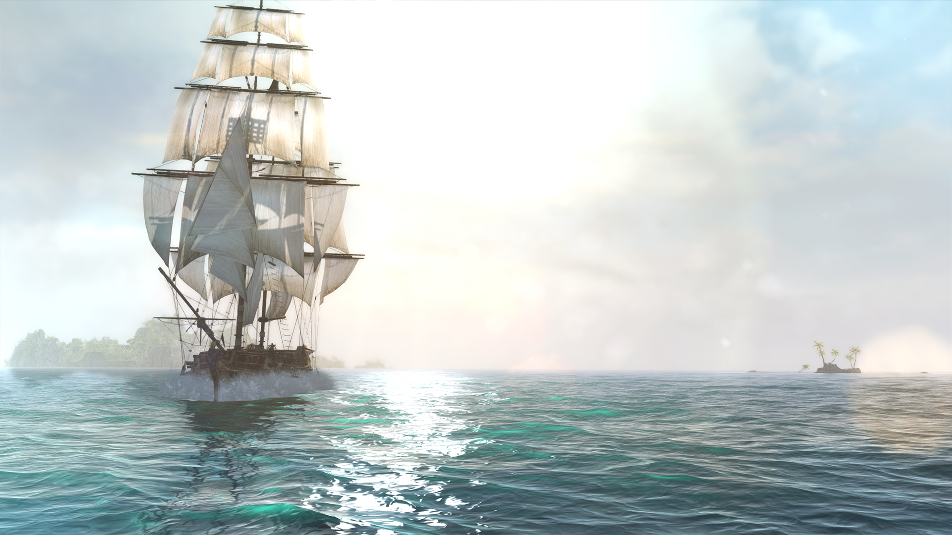
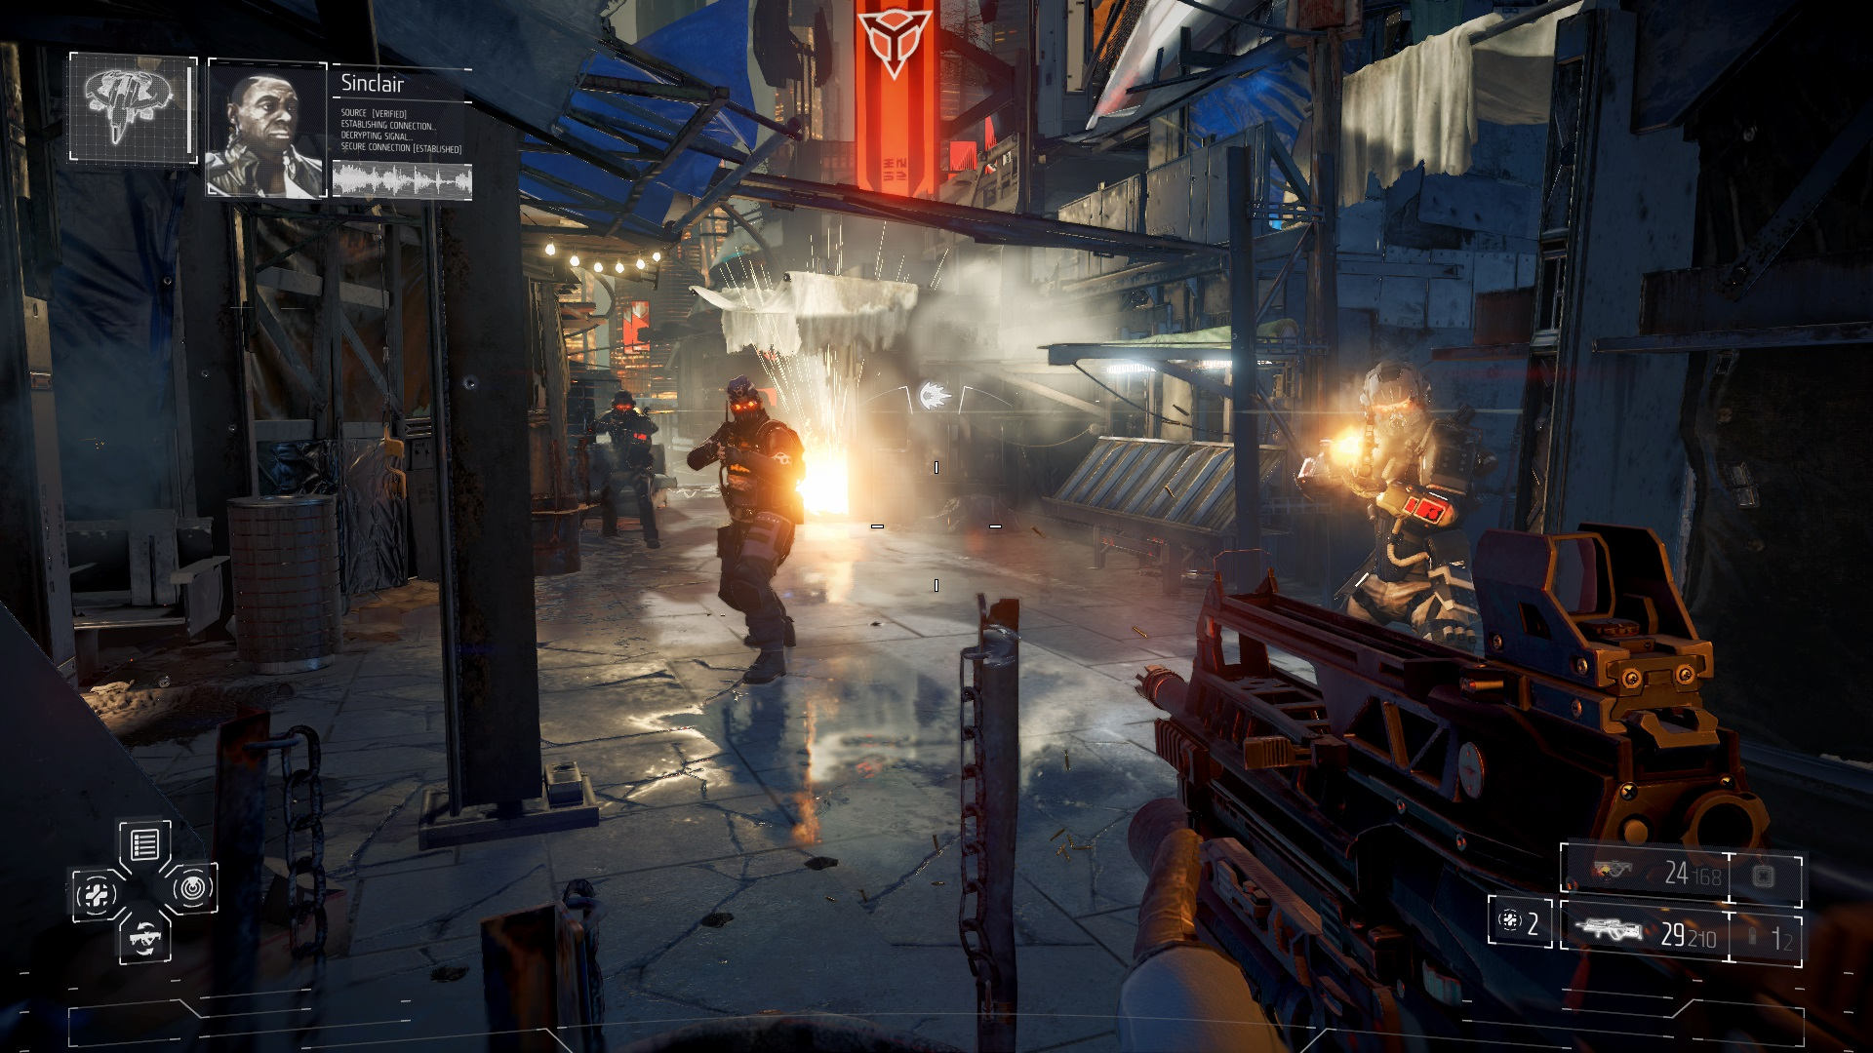
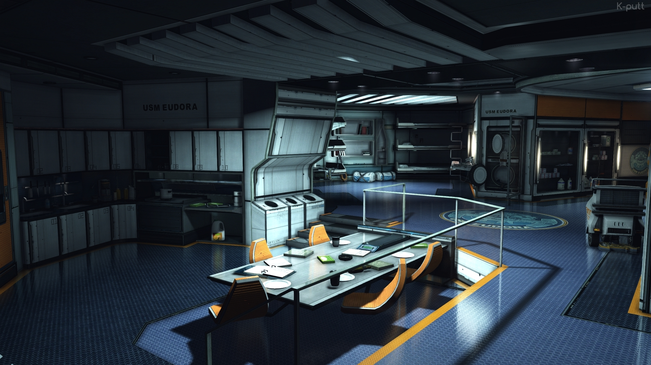
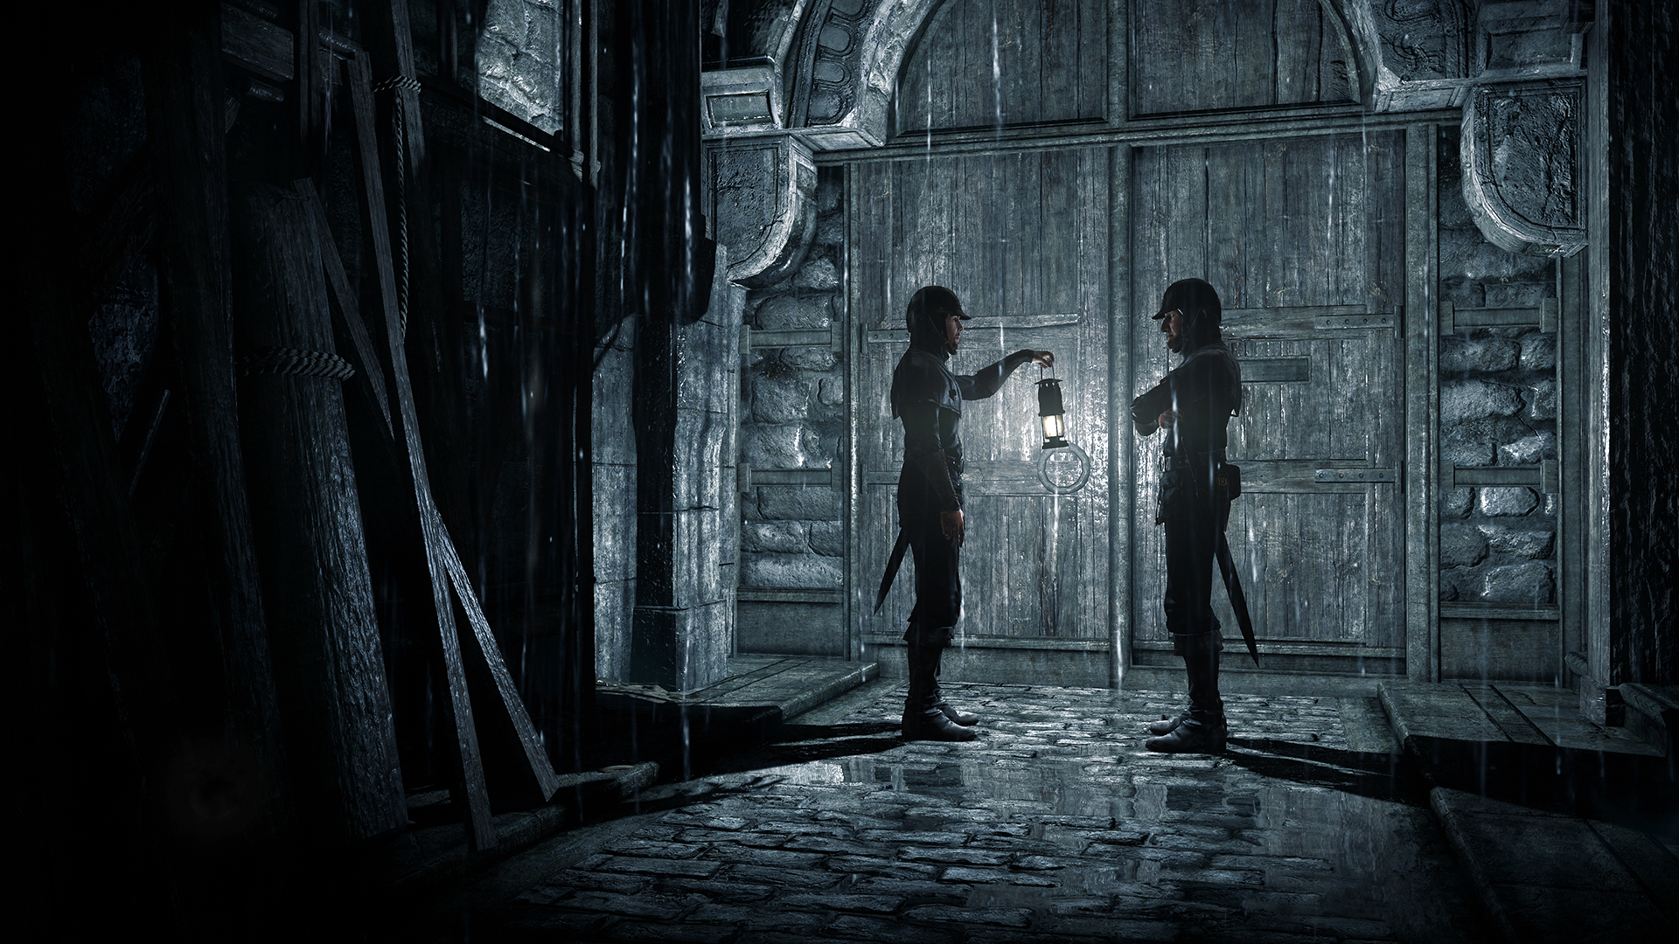
Assasin’s Creed IV
Ubisoft Montreal, 2013
Killzone Shadow Fall
Guerilla Games, 2013
Dead Space 3
Visceral Games, 2013
Thief
Eidos Montreal, 2014
Notes:
Here is a selection of visually stunning games; note that they all have apparent reflections. Reflection is hard to render in realtime because it is indirect illumination; we have some battle-tested techniques for diffuse that work well (such as lightmapping), but the problem is reflection is view dependent.
Top Left: Assassin’s Creed 4 (Assassin’s Creed 4: Road to Next-gen Graphics; GDC 2014)
Top Right: Killzone Shadow Fall (REFLECTIONS AND VOLUMETRICS OF KILLZONE SHADOW FALL; Advances in Realtime Rendering; SIGGRAPH 2014)
Bottom Right: Thief (Reflection System in Thief; Advances in Realtime Rendering; SIGGRAPH 2014)
Bottom Left: Dead Space 3

Slide 3
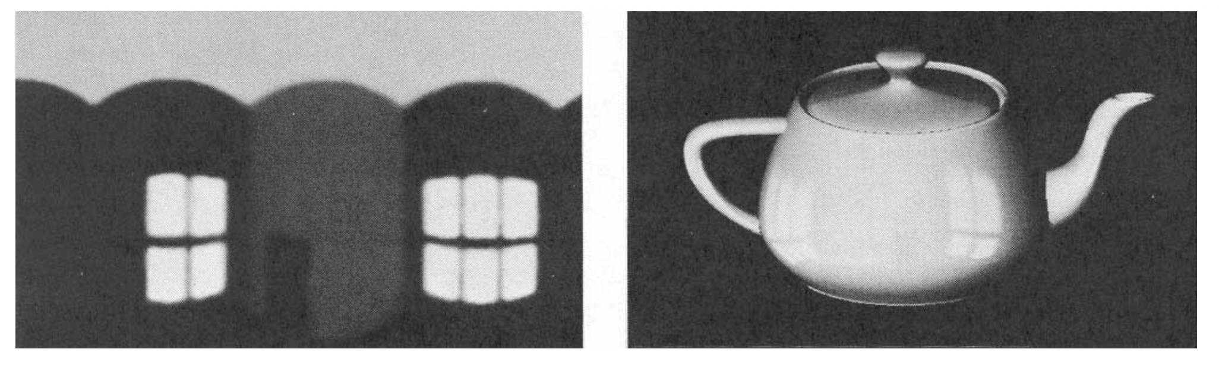
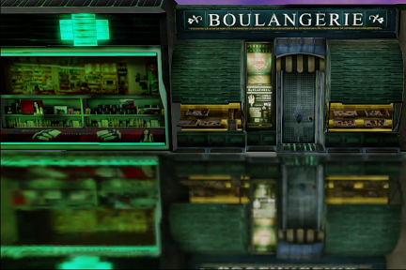
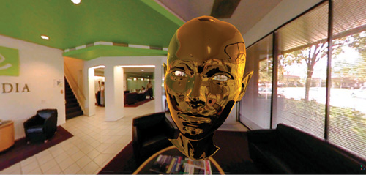
Warped Light Probes
Blinn’76 -> Bjorke’04 -> Lagarde’12
James F. Blinn and Martin E. Newell Texture and Reflection in Computer Generated Images. Communications of the ACM, 1976
Bjorke, Kevin. Image-based lighting. GPU Gems (2004): 307-322.
Sébastien, Lagarde, and Antoine Zanuttini. Local image-based lighting with parallax-corrected cubemaps. ACM SIGGRAPH 2012 Talks. ACM, 2012.
Notes:
The most widely used technique in real time graphics for simulating reflections are light probes. This use of lightprobes has a long lineage in the literature; starting with Blinn and Newell’s paper back in 1976, moving through Bjorke's Image Based Lighting a decade ago, and recently " Local Image-based Lighting With Parallax-corrected Cubemap" presented by Lagarde at SIGGRAPH 2012.

Slide 4
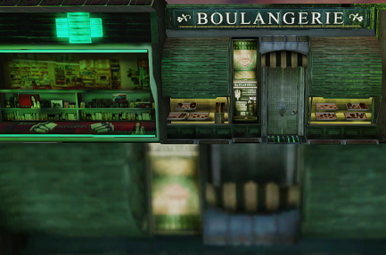
Parallax Corrected Cubemap [LagardeZanuttini2012]
Notes:
Regular lightprobes are only valid for a single point. By using convex volume proxies you can correct for parallax to get more accurate reflections; but there are significant limitations

Slide 5
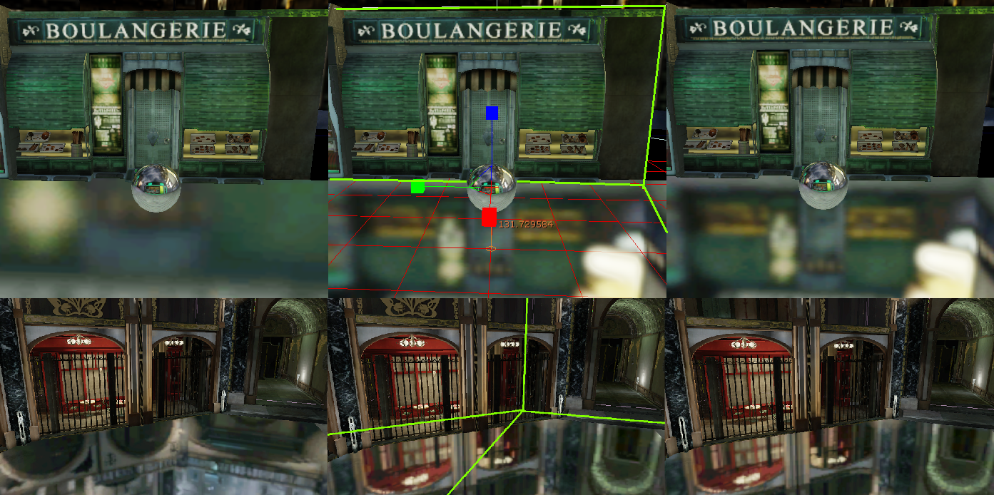
Light probes are inaccurate away from their center,
even with sophisticated parallax correction
and significant artist intervention
Notes:
Real geometry doesn’t consist of simple convex shapes;
automatically-placed probes can end up inside or too close to geometry
And manually-placed probes and proxy volumes are expensive to produce

Slide 6
Warped Light Probes
Blinn’79 -> Bjorke’04 -> Lagarde’12
Require manual placement [LagardeZanutti2012]
Limited by probe resolution
High latency for dynamic objects
Notes:
Furthermore you can't micro-render very many probes per frame even on today's best GPUs without really good LOD, and good LOD is yet another manual placement issue...

Slide 7
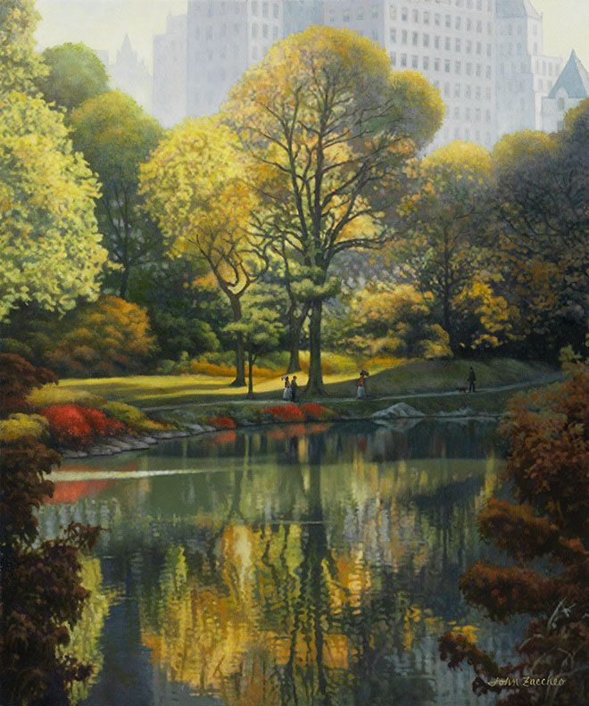
Intuition from Painting
Reflection does not need to be perfect to be plausible.
Visible surfaces most important to “see” in reflection.
Screen-space approach
Notes:
So we want to try a different approach. For inspiration, we can look towards painters, who have been able to render plausible reflections for centuries without doing complex calculations to find true reflection hitpoints in their paintings. This teaches us that reflection does not need to be perfect to be plausible.
In fact, if you look at several paintings or perhaps ask your artist friends, you will find out that they are creating reflectiong basically just painting slightly distorted versions of what they “see” in the rest of the screen.
This suggests we can take a screen space approach.

Slide 8
Screen-Space Ray Tracing
Bart Wronski. Assassin’s Creed 4: Road to Next-gen Graphics. GDC 2014
Michal Valient. Reflections and Volumetrics of Killzone Shadow Fall. SIGGRAPH 2014
Peter Sikachev & Nicolas Longchamps. Reflection System in Thief. SIGGRAPH 2014
Notes:
This brings us to screen-space raytracing. Various implementations are already in shipping games, and there were a string of presentations on lighting systems incorporating screen space raytracing last year.
The basic idea is to use the depth buffer as a proxy for the scene geometry and march the depth buffer to trace rays.

Slide 9
Today’s Talk
Principles and Practice
Derivation from DDA
Optimizing for vector processors
(Full source on our website)
Generalize
Extend to multiple layers
Tune for robustness
Apply to arbitrary raycasting algorithms
An extension of this method will ship in Unity 5.x
Notes:
In today’s talk I will sketch how to derive this algorithm from the traditional Digitial Differential Analyzer; I will then touch on how we optimized it for current GPUs; you can grab full source code on the JCGT website.
I will also talk about generalizations of the technique, tuning for robustness and apply it to a variety of algorithms that use raycasting.

Slide 10
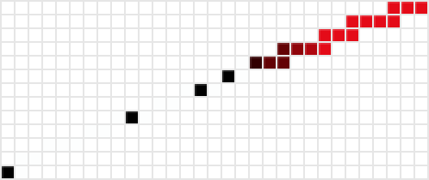
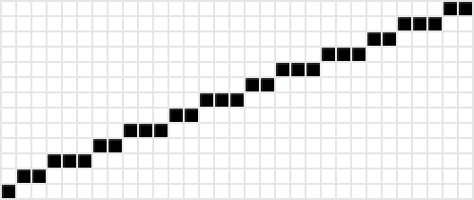
3D
2D
Notes:
Now if you hear the phrase “screen-space raytracing,” the first thing that you might think of is 3D linear ray marching, like the demo scene uses. This is how the very first screen-space ray casters worked
On most hardware, the ray march is usually limited to a small number of iterations to ensure real-time performance.
Due to perspective, marching in regular steps along a 3D ray doesn't generally give uniformly spaced 2D steps across the screen.
This means that the limited number of samples are distributed poorly, often the ray will skip away from the surface too quickly, missing near-by objects.
It will then bunch up the remainder of the samples on a few pixels, limiting how far away reflecting objects can be and wasting computation sampling the same pixels repeatedly (shown here in red)
We want a technique that samples evenly in screenspace, as in the lower image. You may notice that that image look suspiciously like a rasterized line.

Slide 11
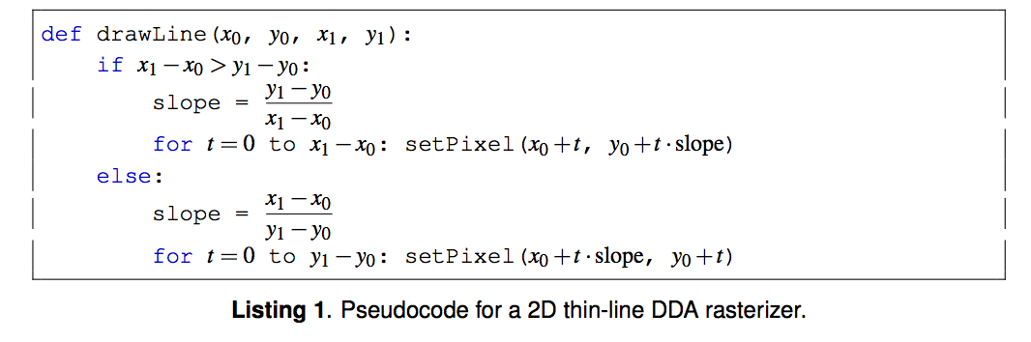
Digital differential analyzer (DDA)
Notes:
We note that marching along a 3D ray with samples placed at unique and adjacent 2D pixels is equivalent to perspective-correct rasterization of the portion of the ray that lies within the view volume.
So we adapt a thin-line rasterization algorithm, the digital diffrential analyzer.
This algorithm was designed for a single-threaded CPU!
On a GPU, we’re executing hundreds of instances in parallel on a vector processor. This branch…

Slide 12
Digital differential analyzer (DDA)
Notes:
Halves our performance because of divergence

Slide 13
Divergence
Warp
…
if x₁ – x₀ > y₁ – y₀:
xMajorIteration()
else:
yMajorIteration()
…
½ performance for each branch!
Notes:
GPUs group pixels into “warps” or “wavefronts” of adjacent pixels, each of which runs on a single core of a superscalar processor.
Here we assume the ray is in the first quadrant of the plane. Green threads represent rays where the slope of the ray in screen space is less than one, and blue thread have slope more than 1
At a statement where pixels within a group branch in different directions, the GPU must compute both sides of the branch, issuing no operation to a portion of the vector lanes for each branch and this is the case even if only a single thread in a warp takes a particular branch. So, while branch instructions themselves are often relatively expensive compared to arithmetic instructions, their most important cost is that divergent execution will reduce throughput by one half for each nested branch.
Note that this code only handles the first quadrant; we need 2 more nested branches to handle all four quadrants in naïve implementation
More branches for handling clipping to viewport
Total of 8x reduction in performance for handling all cases, plus overhead for clipping branches against the viewport.
We rederive the algorithm to make it branchless except for the actual hit detection.

Slide 14
Divergence
Warp
…
permuteAxes()
xMajorIteration()
…
No divergence!
Notes:
So we need to fix this. For example, we rewrite the iteration to always be x major and use a conditional move to swap X and Y for drawing y major lines.
We do a similar permutation to eliminate the 2 branches needed for the quadrants of the plane; so after setup our iteration code can pretend all rays in the first quadrant with slope < 1.

Slide 15
Optimizations
Divergence
Permute axes for 8x improvement
Displace 0-pixel lines to avoid degenerate special case
Operation count
Clip to z outside the loop
Compute homogeneous-space derivatives on iteration axis, use only FMUL for inner loop
Use depth-buffer boundary to avoid explicit XY
Others
Favor multiplying by precomputed inverses instead of dividing
Minimize peak register count
Notes:
I motivated the branch problem with the different 45-degree octants of the plane; we compute a permutation that maps these in and out of a single octant and thus eliminates all branches for it in the inner loop.
That's an 8x divergence reduction!
We use similar strategies for handling corner cases.
See the paper for full details of all of the vector-processor optimizations listed here; most of which are direct applications of GPU programming best practices.

Slide 16
Parameters
Max iteration count
Max 3D trace distance
Sampling stride (for perf.; stride=1 is regular)
Jitter
Depth buffer thickness
Number of layers
Notes:
We have many parameters so people can tune the algorithm for their use case.
Max iteration count is the easiest knob to turn to trade perf for quality. The less steps you take, the faster the raycast, but also the shorter your reflections in SS. If you were willing to take up to 2 times the width of your screen’s samples per pixel, you could completely ignore this parameter; but for those of us with mortal computation budget, it is absolutely critical.
Max 3D trace distance: this is not orthogonal to max iteration count, but it also serves a separate purpose: reflection of surfaces far away in world space are prone to rapid shifts with only a slight change in camera positioning, which can lead to objectionable temporal flicker. Setting this parameter can help mitigate that.
Sampling stride. This just lets you skip pixels during iteration. Use this in conjunction with max iteration count to trade quality/perf. The larger the stride, the longer the ray can be cast with the same # of samples, but the more likely to miss the true intersection, and cause banding. If you cast many rays per pixel; or do a convolution afterwards, say for glossy reflection, that might be perfectly acceptable.
The other three: Jitter, depth buffer thickness and number of layers I will talk about a bit more

Slide 17
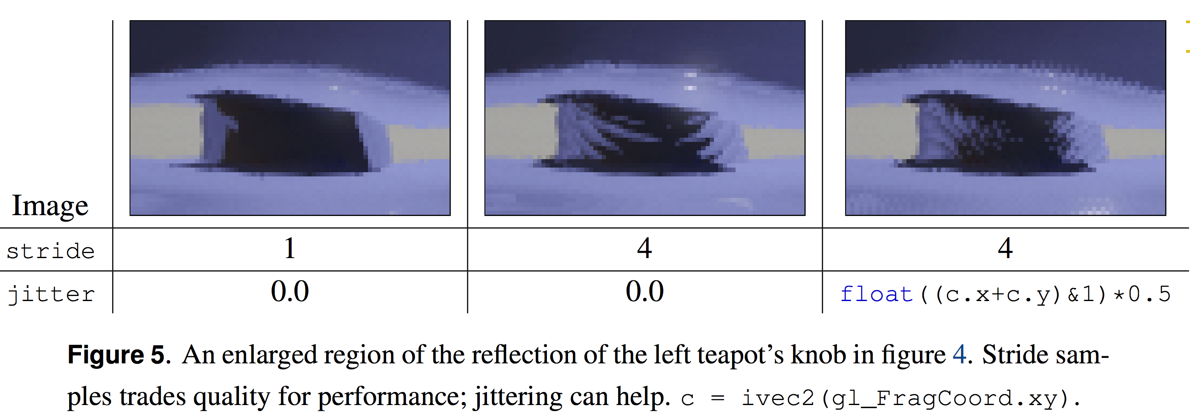
Jittered Sampling Reduces Banding
Notes:
When stride > 1, we get banding in our results; this can be traded for noise by jittering the start position of each ray.

Slide 18
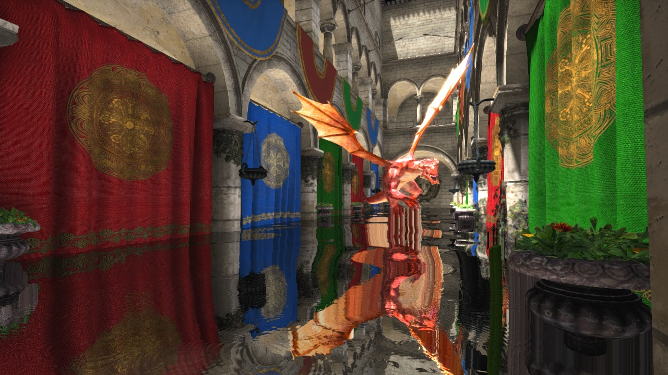
Depth Buffer Thickness = 1000m
Notes:
Many previous implementations treat each texel in the depth buffer as an infinitely long frustum, which causes artifacts when that assumption is inevitably broken in practice. See how thick the dragon appears in the reflection

Slide 19
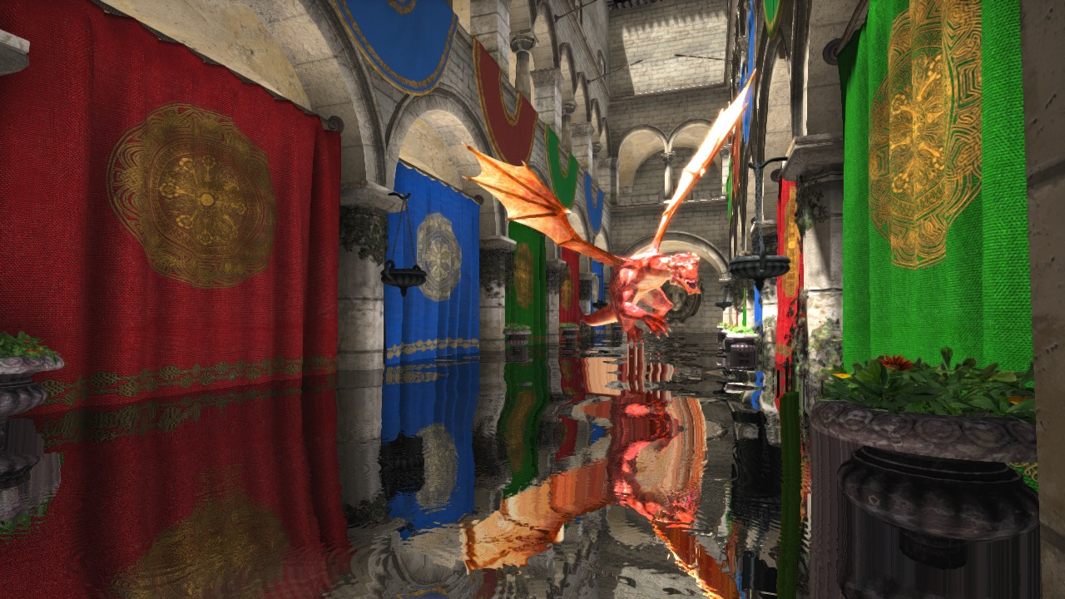
Depth Buffer Thickness = 5m
Notes:
By allowing explicit lengths for the frusta defined by the depth buffer texels we can mitigate these artifacts; and allow rays to hit geometry further back even if they cross closer geometry in screen space.

Slide 20

Depth Buffer Thickness = 2m
Notes:
Results are most accurate and plausible when this value is set to the average thickness of objects in your scene. We found a half-meter to a meter to work well on a wide variety of scenes.

Slide 21
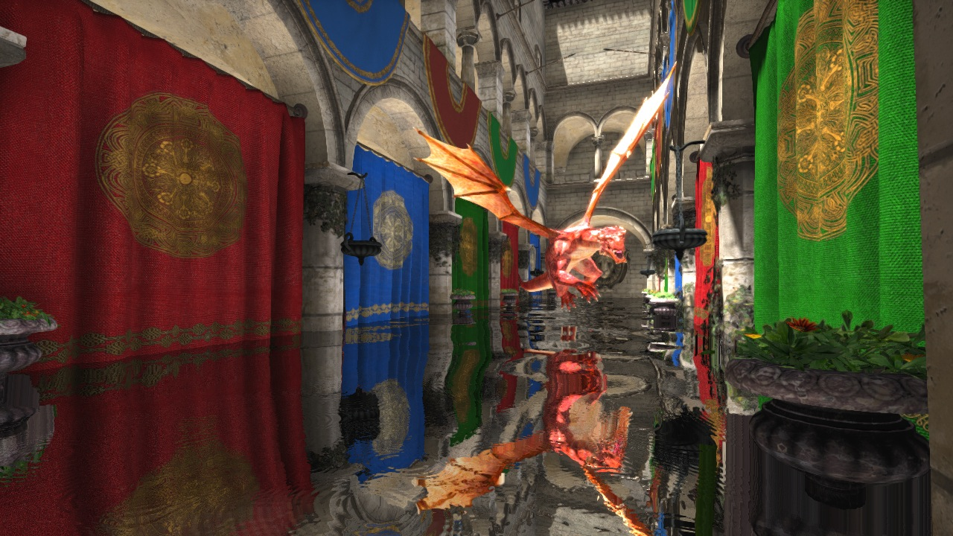
Depth Buffer Thickness = 1m
Notes:
Of course this is not a perfect solution; we simply don’t have perfect geometry data given we work only off of the depth buffer; But it is fast.

Slide 22
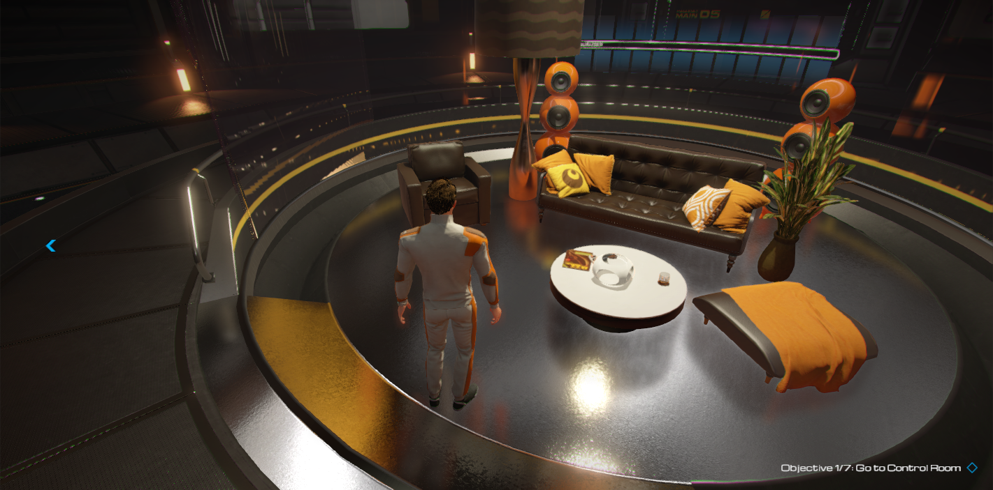
Microfacets and Glossy Reflection
[Valient2014]
© 2015 Unity & Casual Effects
Notes:
If you are using screen space raytracing, but want it to work on surfaces that are not perfect mirrors, you have to do a little more work. We can use Michal Valient’s method presented at last year’s SIGGRAPH.

Slide 23
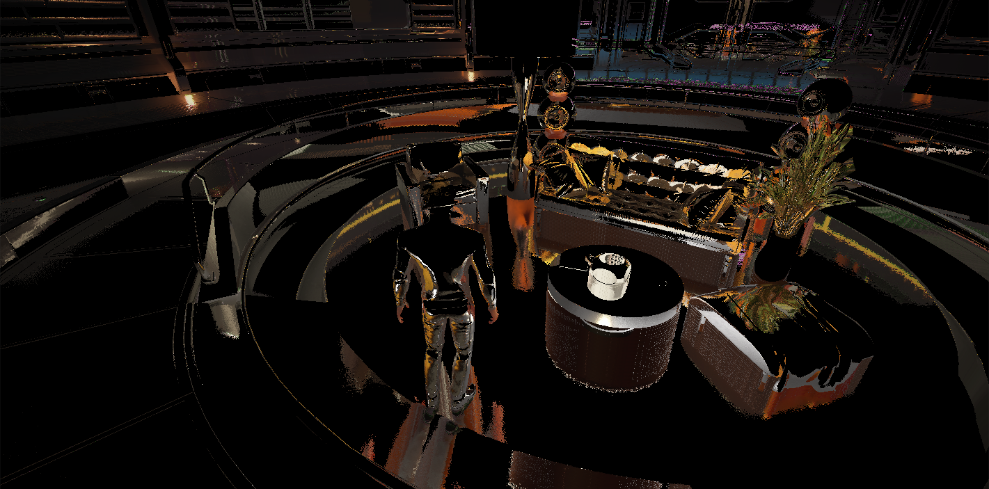
Microfacets and Glossy Reflection
© 2015 Unity & Casual Effects
© 2015 Unity & Casual Effects
Copyright 2015 Unity & Casual Effects
Notes:
First, we trace rays from all glossy surfaces as if they were perfect mirrors; sample the radiance from the color buffer, and store the results in a reflection buffer.

Slide 24
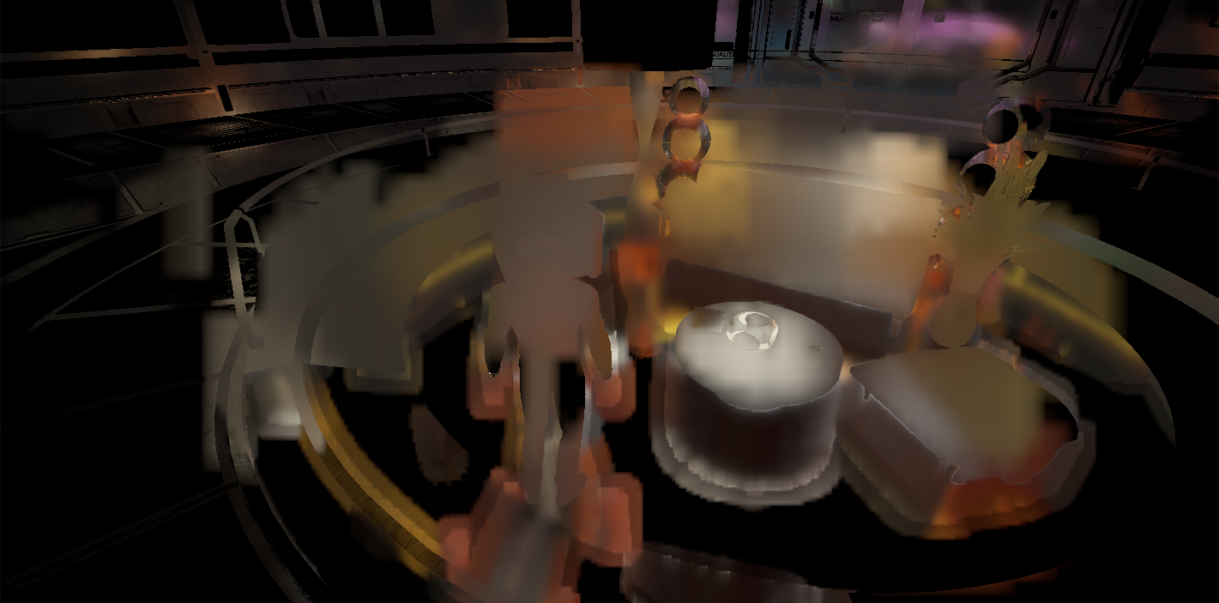
Microfacets and Glossy Reflection
[Valient2014]
© 2015 Unity & Casual Effects
Copyright 2015 Unity & Casual Effects
Notes:
We then filter these results based on surface roughness. Rougher surfaces convolve more texels together to approximate convolution of a fatter glossy lobe in their BRDF

Slide 25
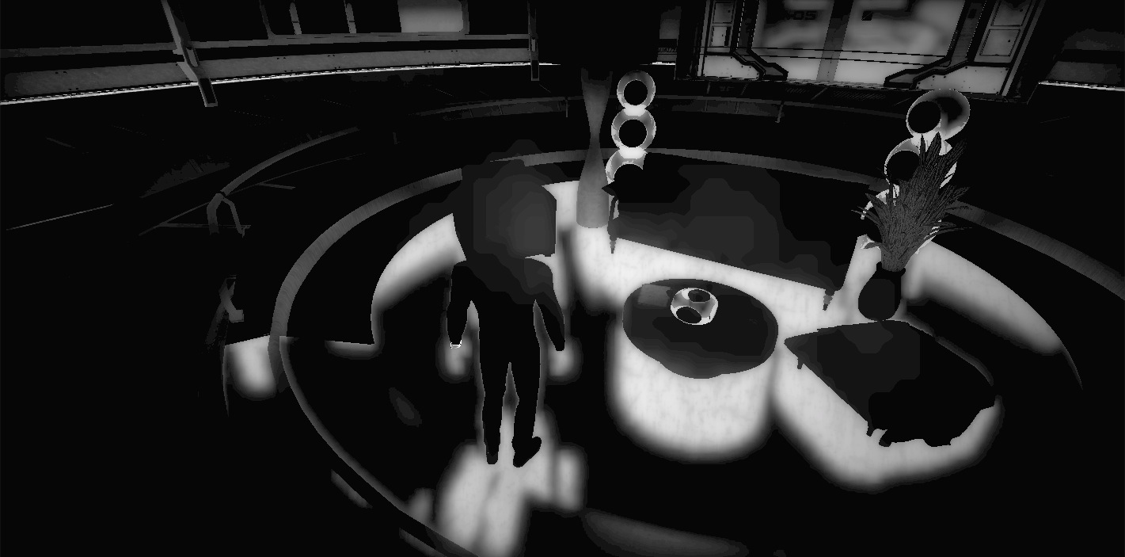
Microfacets and Glossy Reflection
[Valient2014]
© 2015 Unity & Casual Effects
Copyright 2015 Unity & Casual Effects
Notes:
At the same time, we compute confidence values for each pixel. We use these confidence values to lerp between the SSR solution and the fallback solution (light probes in this case).
The initial confidence values are determined by a variety of factors, including the distance the ray travelled and how close the ray hitpoint was to the edge of the screen, and are filtered alongside the reflection buffer.

Slide 26
Microfacets and Glossy Reflection
[Valient2014]
© 2015 Unity & Casual Effects
Copyright 2015 Unity & Casual Effects
Notes:
And finally it all comes together

Slide 27
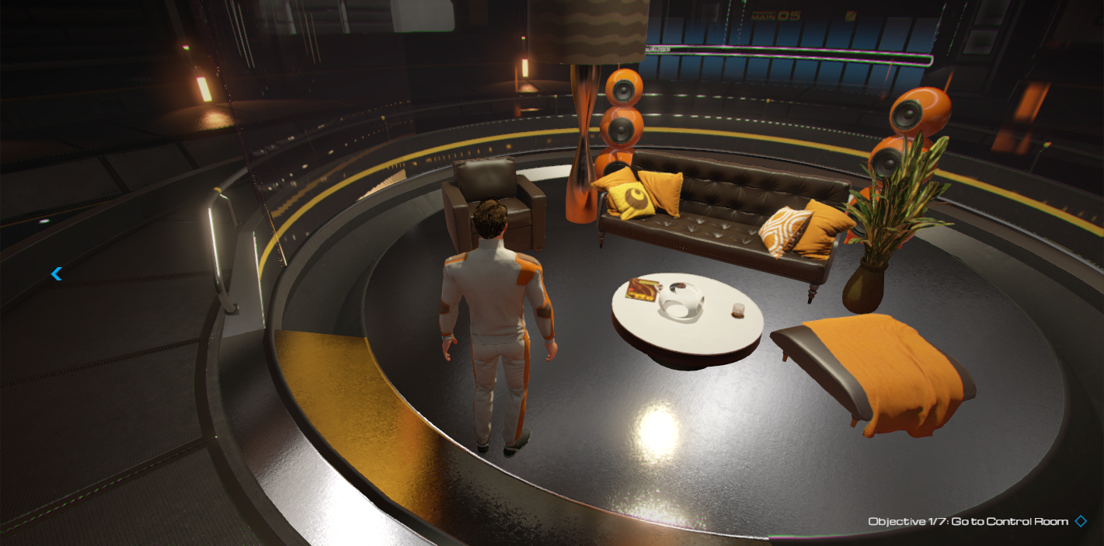
Microfacets and Glossy Reflection
© 2015 Unity & Casual Effects
Notes:
For comparison, here is the same scene *without screen space reflections* (Switch back and forth)
more information about the Unity implementation in our GDC talk, Monday at 3p

Slide 28
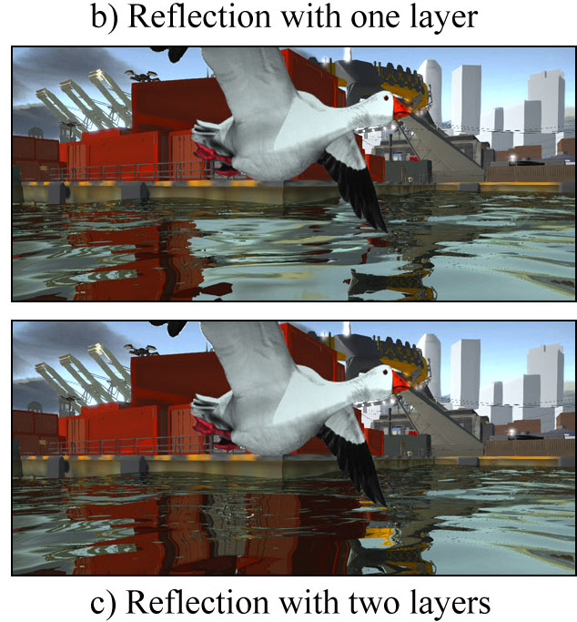
Layered Screen-Space Ray Casts
Mitigate artifacts with multiple layers
Isn’t depth peeling slow?!
See our upcoming fast peeling for Maxwell GPUs
Fast Global Illumination Approximations on Deep G-Buffers, Mara, McGuire, Nowrouzezahrai, and Luebke, ACM Transactions on Graphics, 2015 (in submission)
Notes:
#1 Problem: missing data behind surfaces
Recent algorithm generates a robust depth peel in a single, fast pass
In submission ToG paper shows that on the high end of the new NVIDIA Maxwell architecture, these actually become practical.

Slide 29
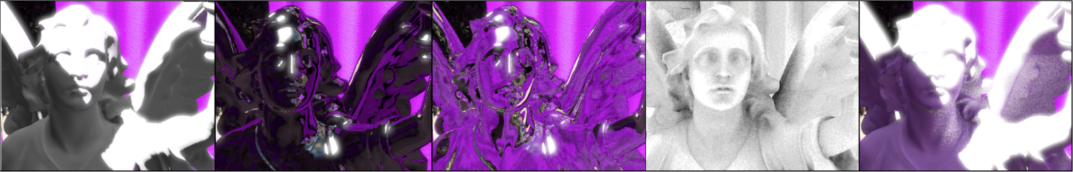
Chrome Reflections
Glass Reflection and Refraction
Raycast Ambient Occlusion
Raycast Radiosity
Notes:
We’ve focused on raytraced reflections. But, once we have a general and robust ray casting primitive, we can build many other graphics algorithms.
With a two-layer buffer we can compute both reflection and refraction...that’s a screen-space Whitted ray tracer!
…we can also cast many rays per pixel for true ray cast AO
…and why not sample colors in that algorithm, for radiosity?
These require a very powerful GPU and were barely real-time when we performed the experiments last year

Slide 30
Thank you
Aras Pranckevičius, Renaldas Zioma, Alex Lian, Kasper Engelstoft, Kuba Cupisz, and the rest of the Unity team
Pat Hanrahan of Stanford
Code is available on the JCGT website!

Slide 31
Bonus Slides

Slide 32
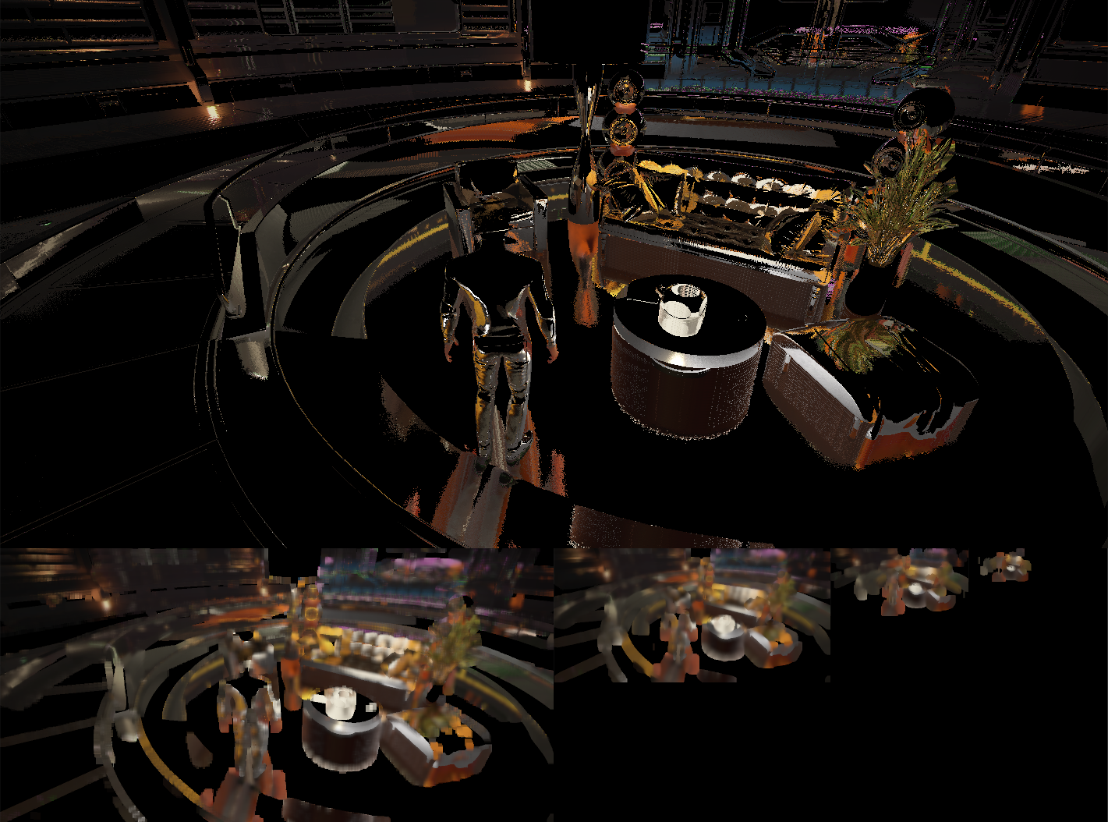

Slide 33
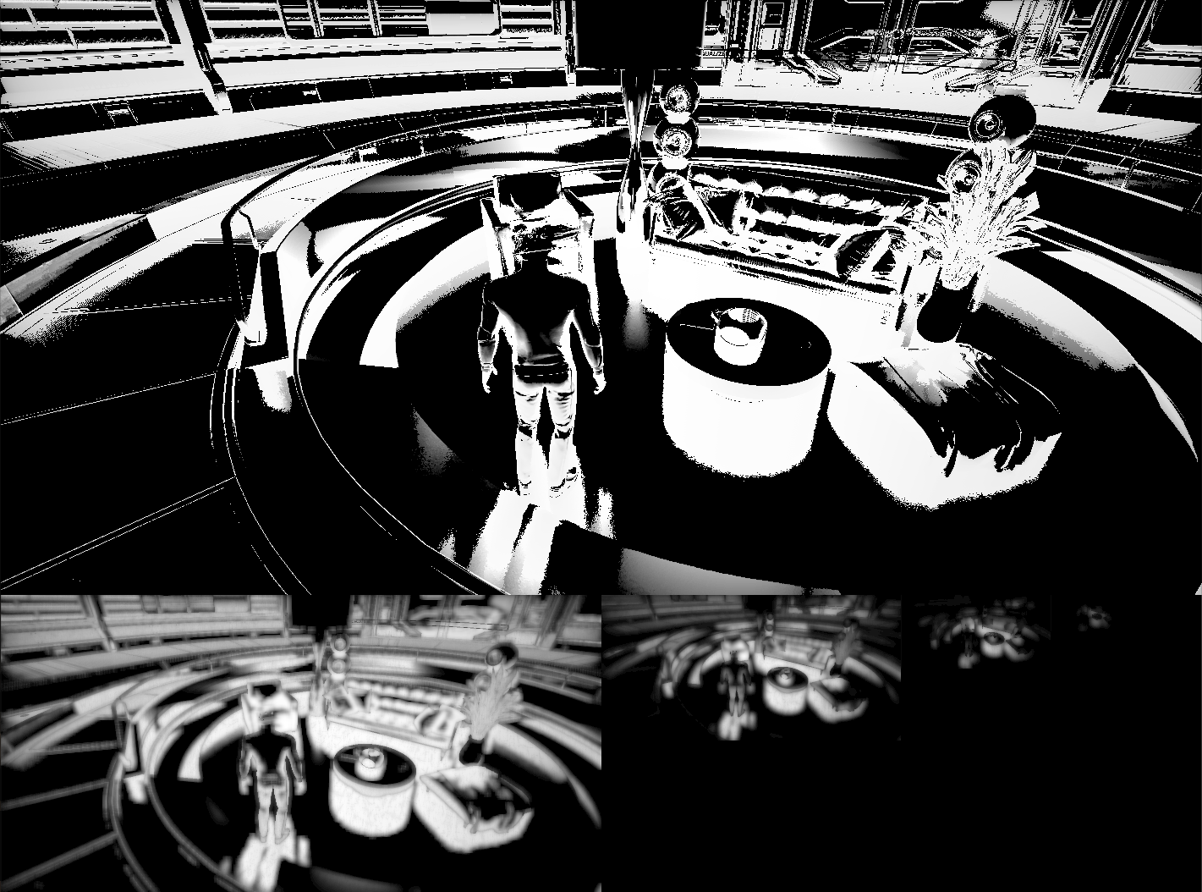

Slide 34
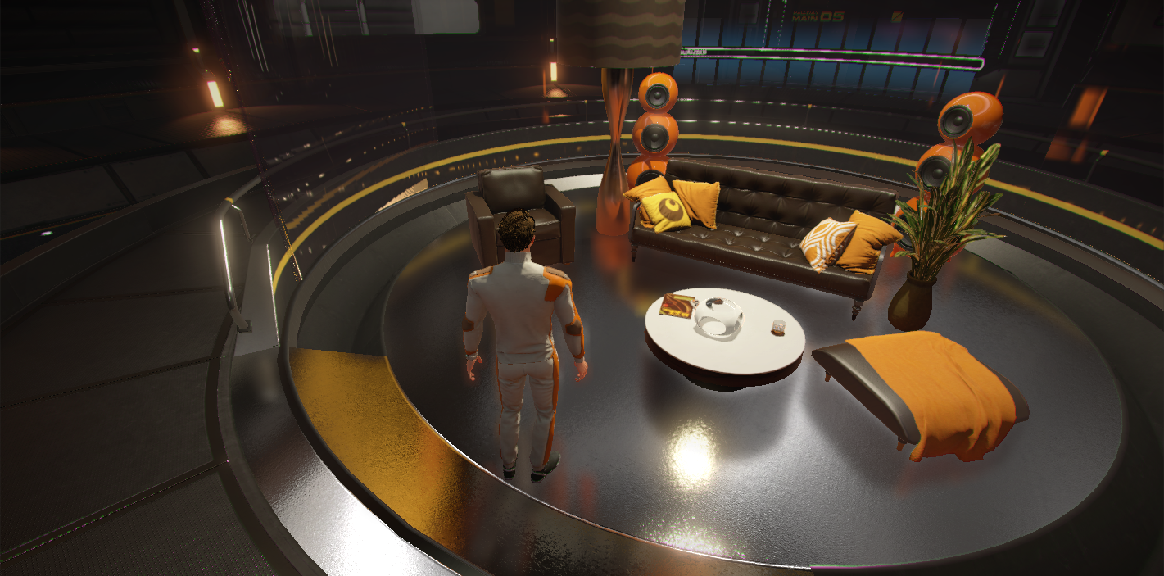

Slide 35
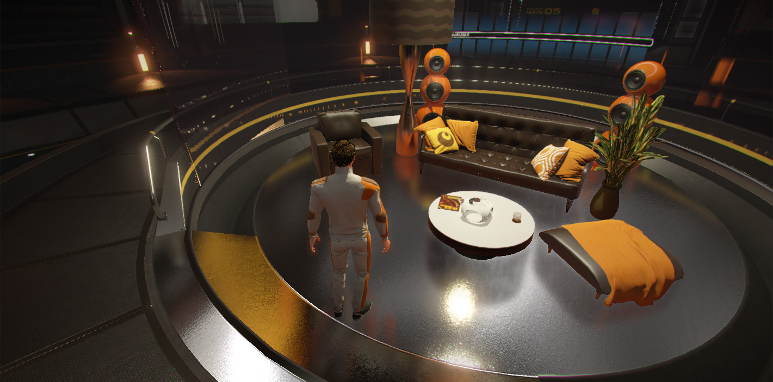
Notes:
Bilaterally filtering during mip construction helps avoid aartifacts.

Slide 36
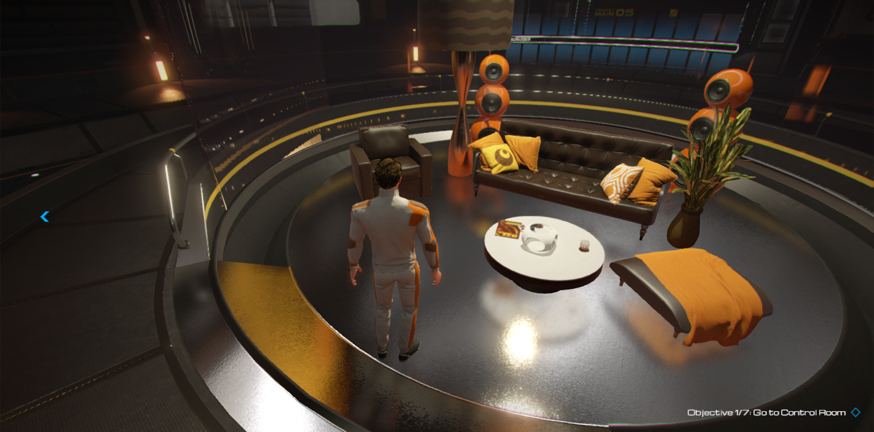

Slide 37

Notes:
Inifinite layer thickness

Slide 39
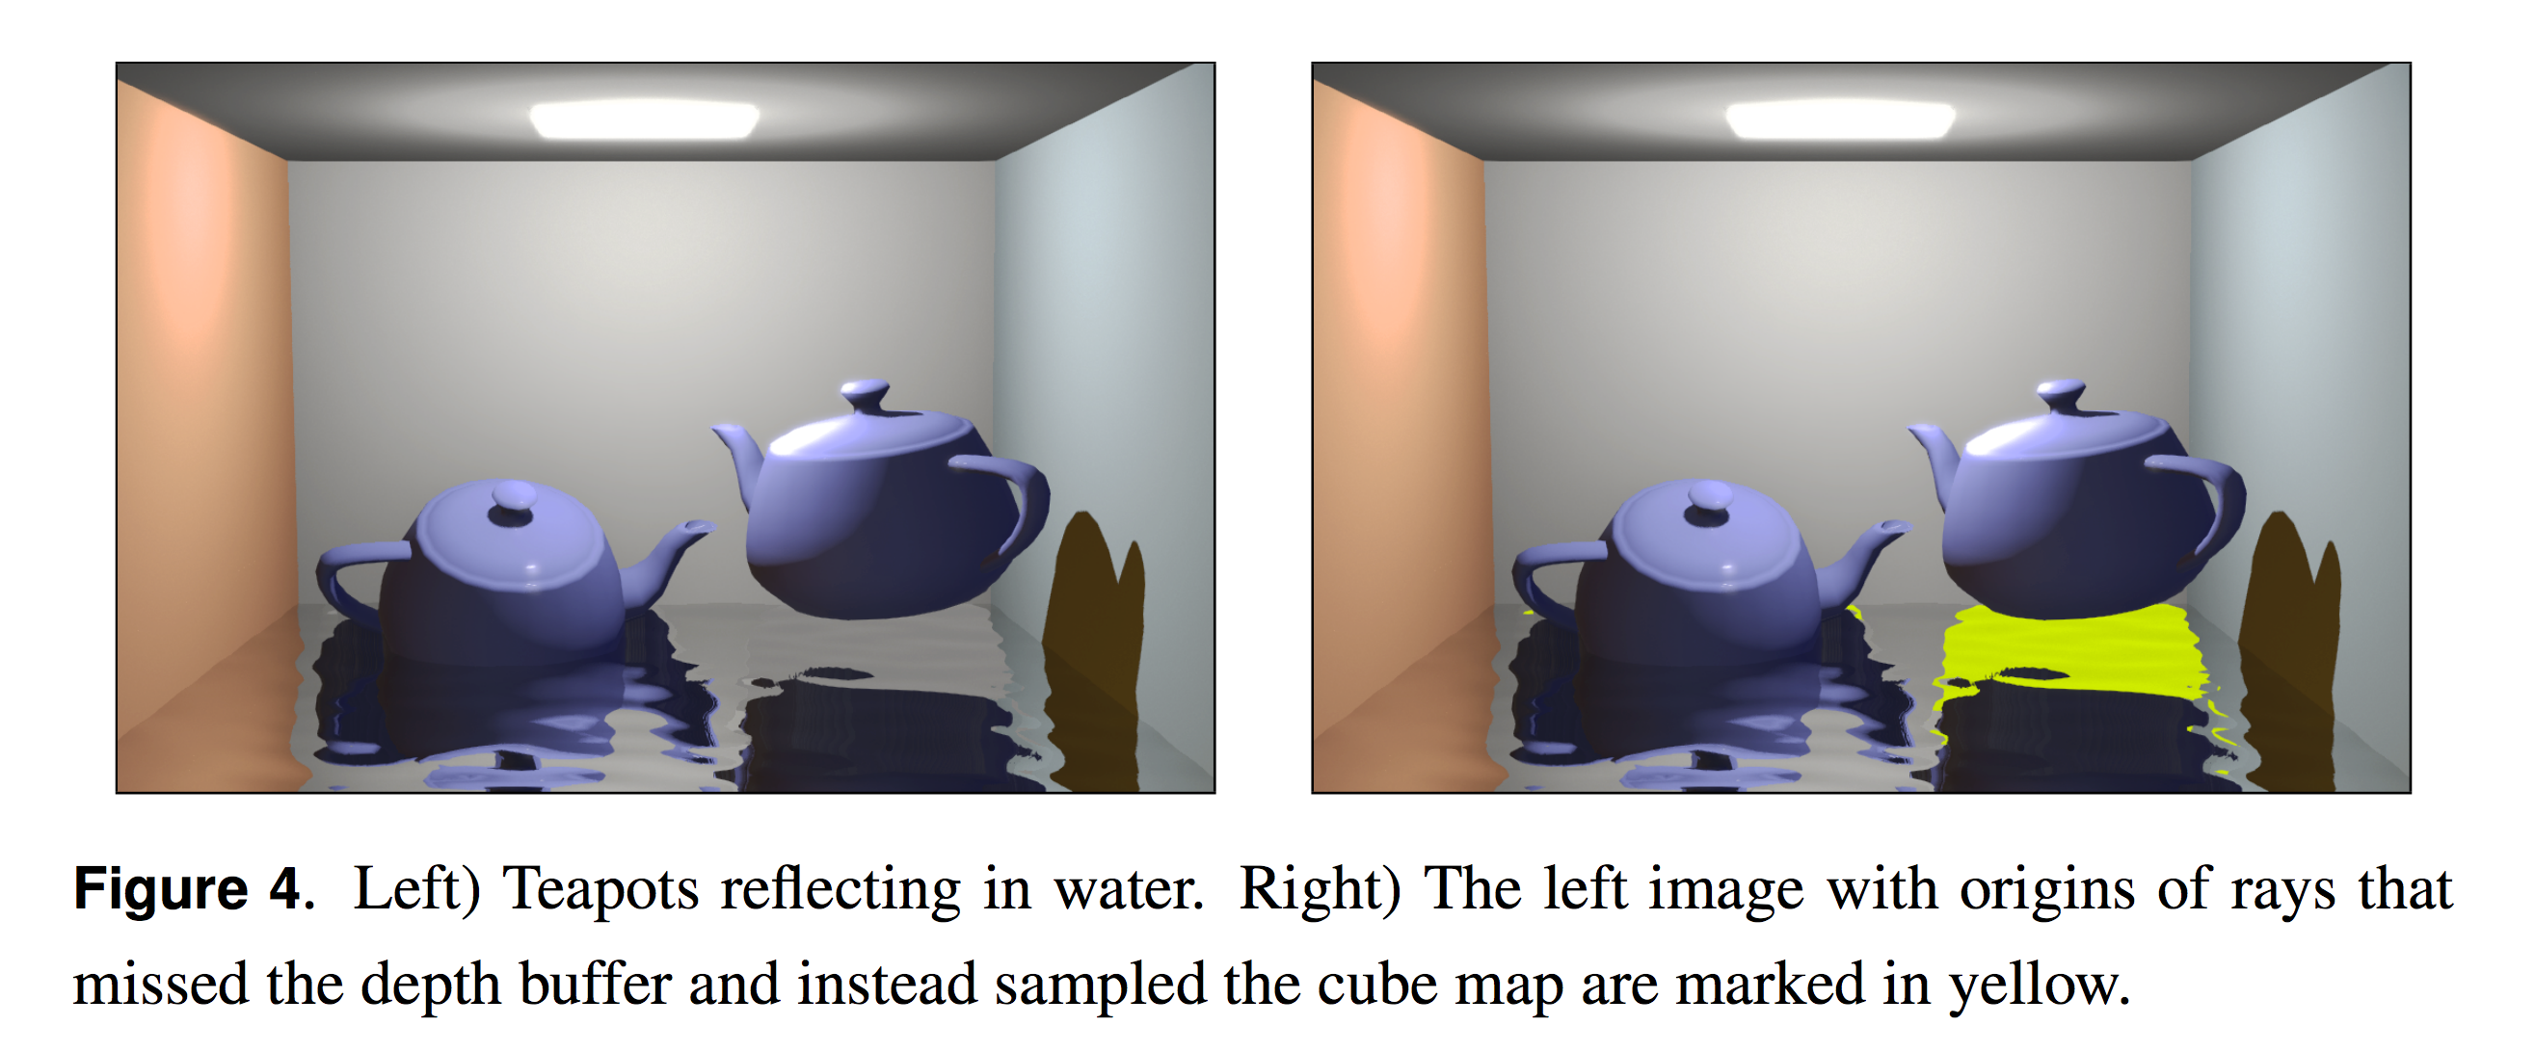
Light Probe Fallback

Slide 40
